Slide 1

Palmetto GBA
MMP High-Level System Diagrams
Last Update 04/08/2014

Slide 2

Table of Contents
Revision History
FERAS/PDFS Diagram
MMP Medicare Diagram
MMP Medicaid and NCPDP Diagram
Acronyms

Slide 3
Revision History
Date Changed | Revision Description
04/08/2014 | Updated per Team Review

Slide 4
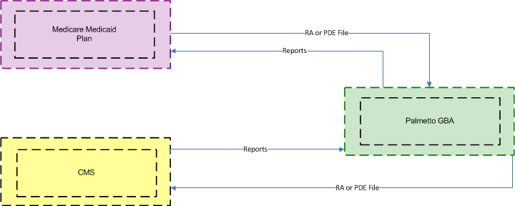
FERAS/PDFS Diagram

Slide 5
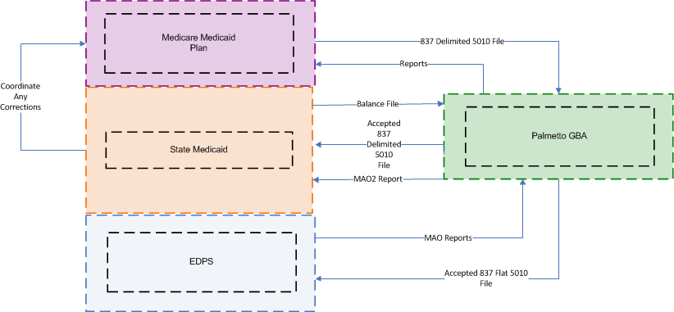
MMP Medicare Diagram

Slide 6
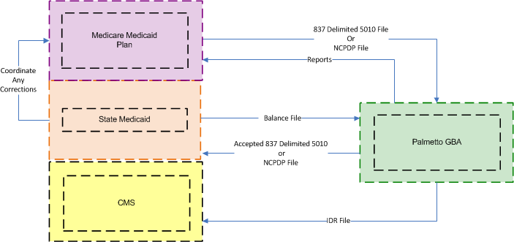
MMP Medicaid and NCPDP Diagram

Slide 7
Acronyms
Acronym | Literal Translation
CMS | Centers for Medicare & Medicaid Services
FERAS | Front End Risk Adjustment System
EDPS | Encounter Data Processing System
MAO | Medicare Advantage Organization
MMP | Medicare Medicaid Plan
NCPDP | National Council for Prescription Drug Programs
RA | Risk Adjustment
PDE | Prescription Drug Event
PDFS | Prescription Drug Front End System

